Slide 1
Introduction to Big Data

Slide 2
What’s Big Data?
No single definition; here is from Wikipedia:
Big data is the term for a collection of data sets so large and complex that it becomes difficult to process using on-hand database management tools or traditional data processing applications.
The challenges include capture, curation, storage, search, sharing, transfer, analysis, and visualization.
The trend to larger data sets is due to the additional information derivable from analysis of a single large set of related data, as compared to separate smaller sets with the same total amount of data, allowing correlations to be found to "spot business trends, determine quality of research, prevent diseases, link legal citations, combat crime, and determine real-time roadway traffic conditions.”

Slide 3
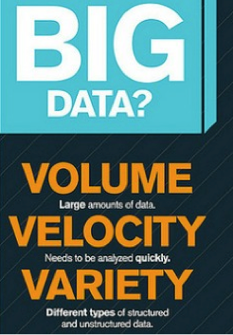
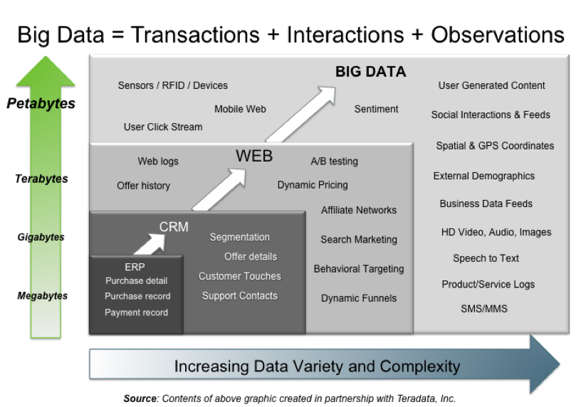
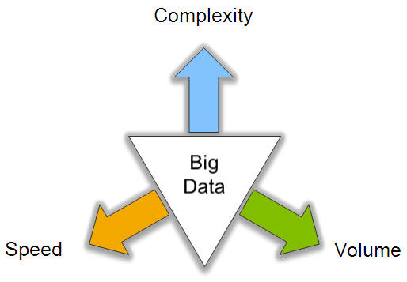
Traditionally, Big Data: 3V’s

Slide 4
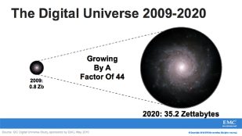
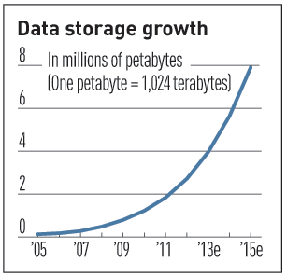

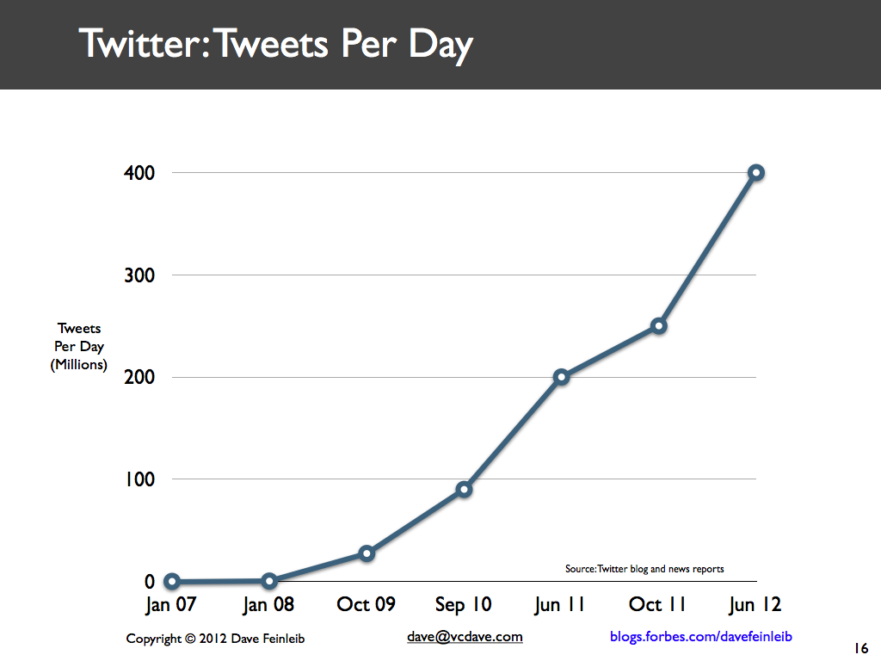
Volume (Scale)
Data Volume
  44x increase from 2009 2020
  From 0.8 zettabytes to 35zb
Data volume is increasing exponentially
Exponential increase in collected/generated data

Slide 5
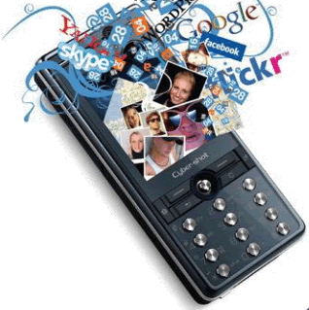
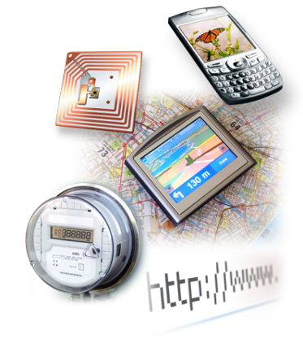

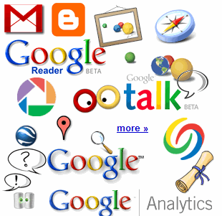

4.6 billion camera phones world wide
30 billion RFID tags today
(1.3B in 2005)
12+ TBs
of tweet data
every day
100s of millions of GPS enabled devices sold annually
? TBs of
data every day
25+ TBs of
log data every day
2+ billion people on the Web by end 2011
76 million smart meters in 2009…
200M by 2014

Slide 6
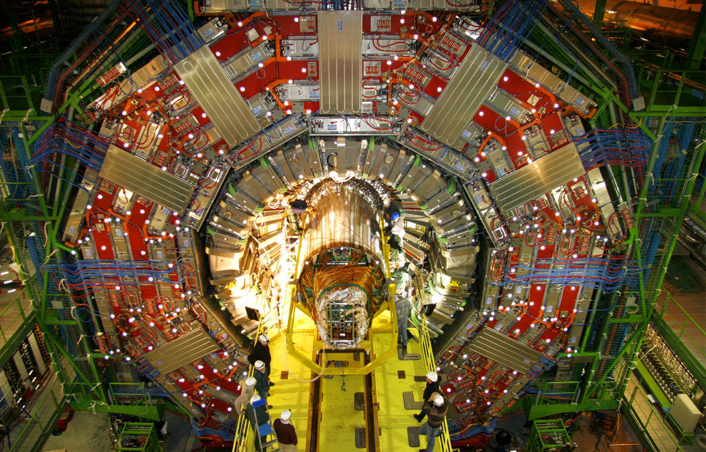
CERN’s Large Hydron Collider (LHC) generates 15 PB a year
Maximilien Brice, © CERN

Slide 7
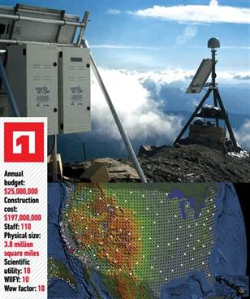
The Earthscope
1.
The Earthscope is the world's largest science project. Designed to track North America's geological evolution, this observatory records data over 3.8 million square miles, amassing 67 terabytes of data. It analyzes seismic slips in the San Andreas fault, sure, but also the plume of magma underneath Yellowstone and much, much more. (http://www.msnbc.msn.com/id/44363598/ns/technology_and_science-future_of_technology/#.TmetOdQ--uI)

Slide 8
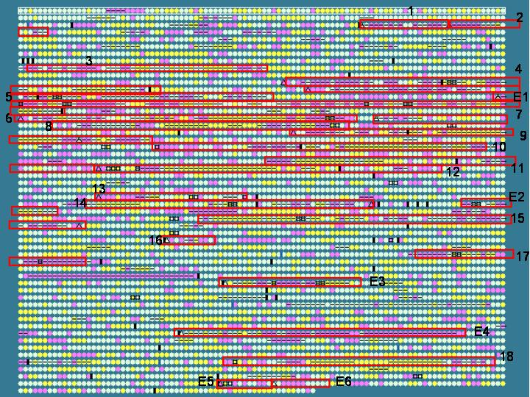
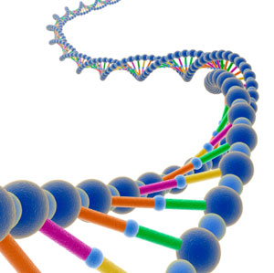
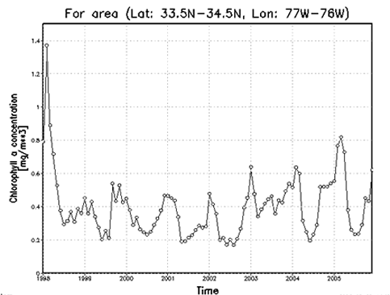
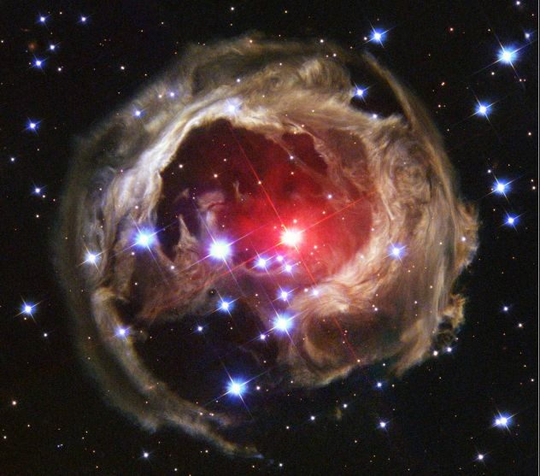
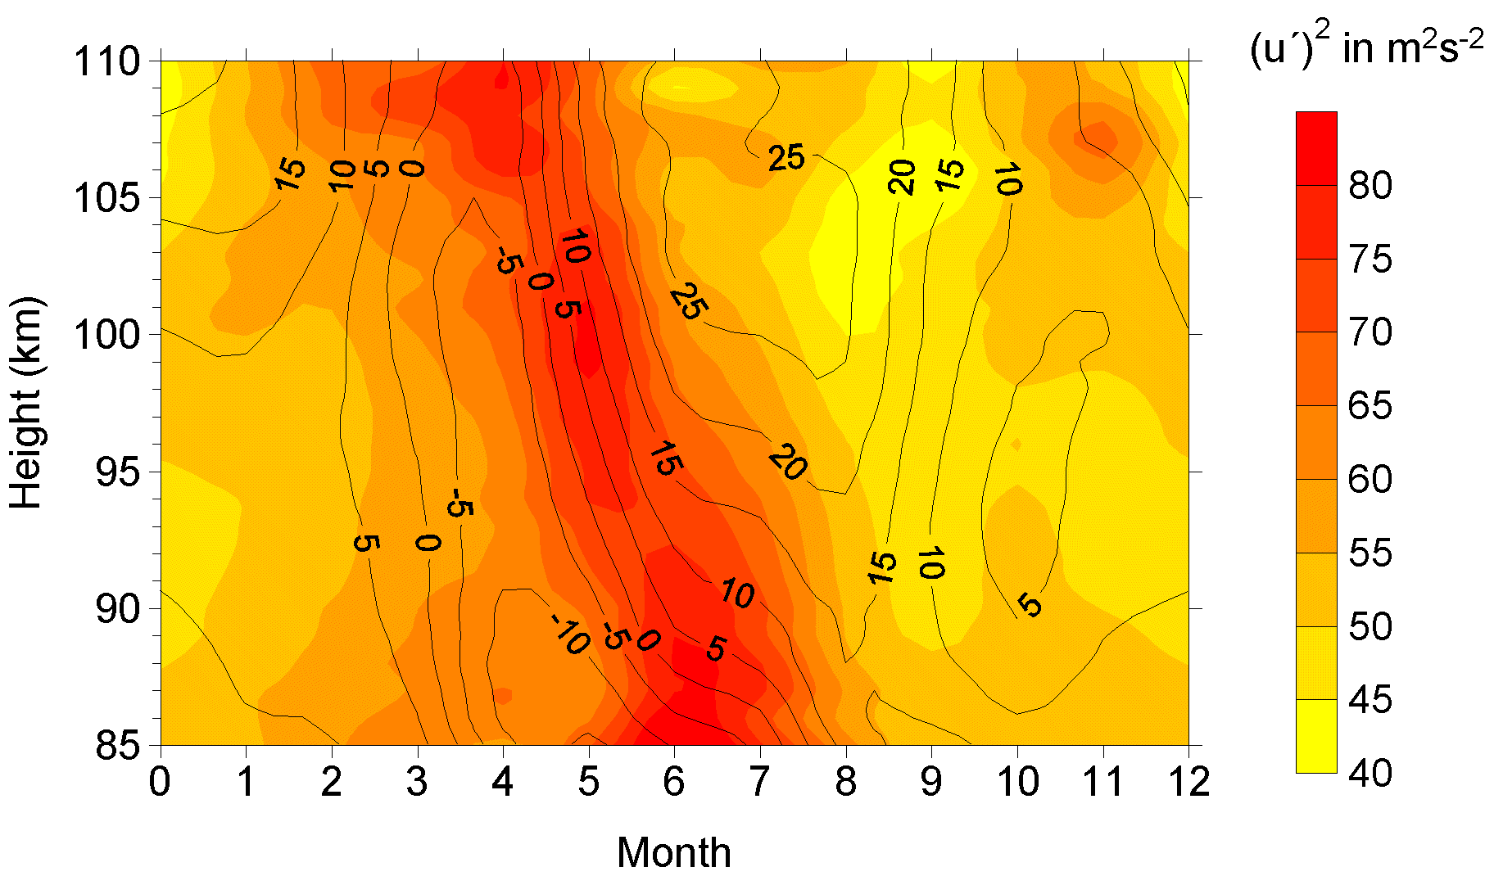
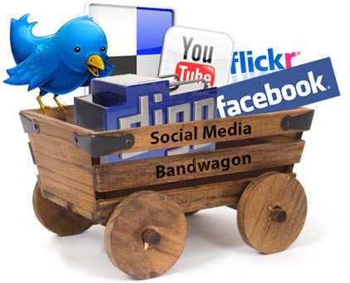
Variety (Complexity)
Relational Data (Tables/Transaction/Legacy Data)
Text Data (Web)
Semi-structured Data (XML)
Graph Data
  Social Network, Semantic Web (RDF), …
Streaming Data
  You can only scan the data once
A single application can be generating/collecting many types of data
Big Public Data (online, weather, finance, etc)
To extract knowledge🡺 all these types of data need to linked together

Slide 9

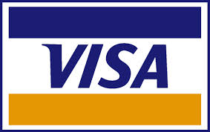







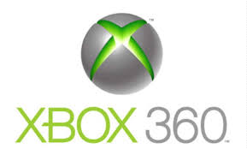







A Single View to the Customer
Social Media
Banking
Finance
Gaming
Our
Known
History
Customer
Entertain
Purchase

Slide 10

Velocity (Speed)
Data is begin generated fast and need to be processed fast
Online Data Analytics
Late decisions 🡺 missing opportunities
Examples
  E-Promotions: Based on your current location, your purchase history, what you like 🡺 send promotions right now for store next to you
  Healthcare monitoring: sensors monitoring your activities and body 🡺 any abnormal measurements require immediate reaction

Slide 11
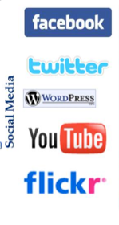
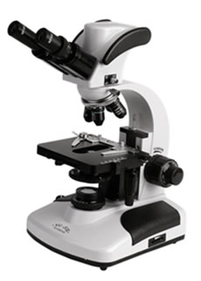
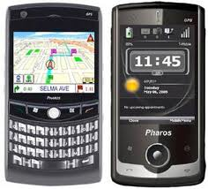
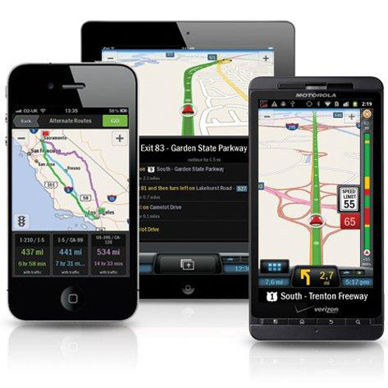
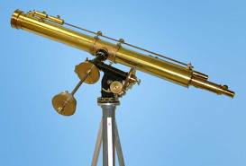
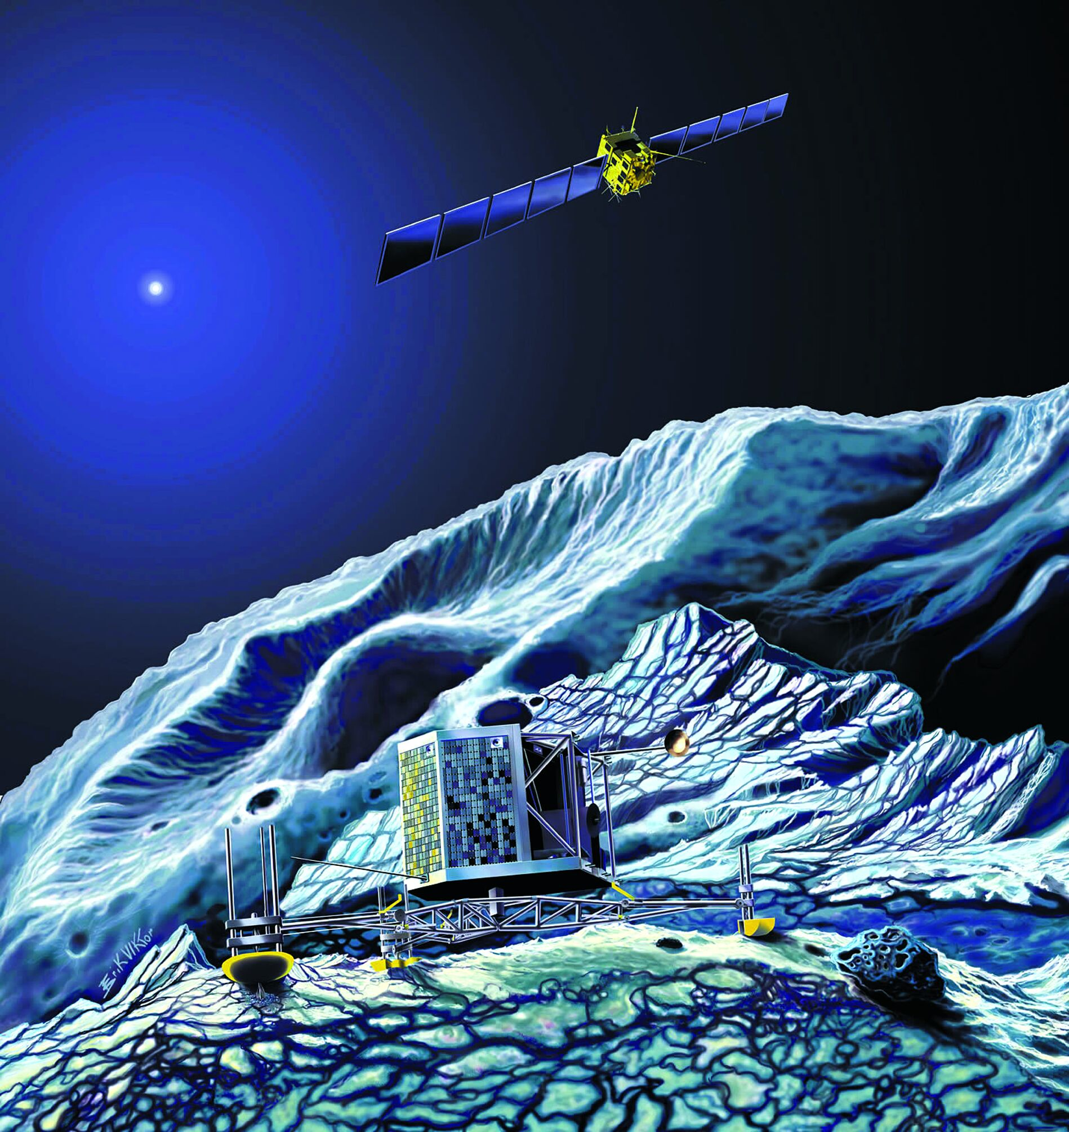
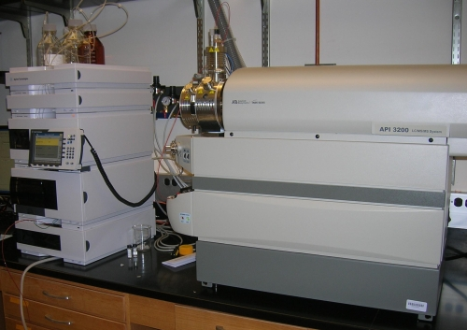
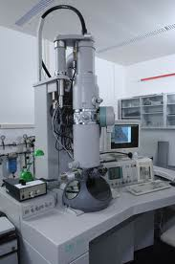
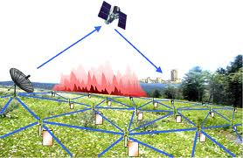
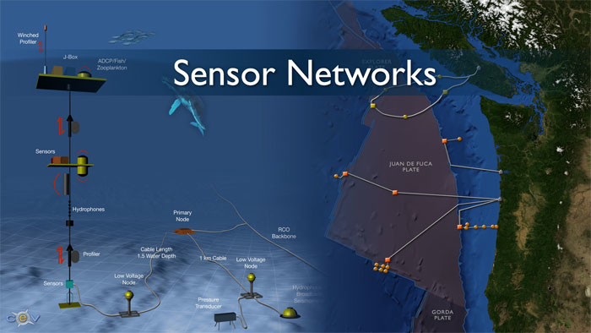
Real-time/Fast Data
Mobile devices
(tracking all objects all the time)
Social media and networks
(all of us are generating data)
Scientific instruments
(collecting all sorts of data)
Sensor technology and networks
(measuring all kinds of data)
The progress and innovation is no longer hindered by the ability to collect data
But, by the ability to manage, analyze, summarize, visualize, and discover knowledge from the collected data in a timely manner and in a scalable fashion

Slide 12
Real-Time Analytics/Decision Requirement
Product
Recommendations
that are Relevant
& Compelling
Learning why Customers
Switch to competitors
and their offers; in
time to Counter
Influence
Behavior
Customer
Friend Invitations
to join a
Game or Activity
that expands
business
Improving the
Marketing
Effectiveness of a
Promotion while it
is still in Play
Preventing Fraud
as it is Occurring
& preventing more
proactively

Slide 13
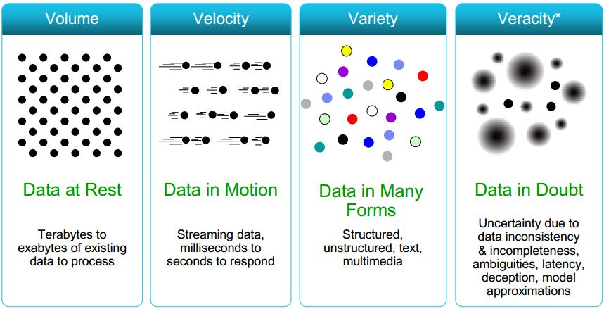
Some Make it 4V’s

Slide 14
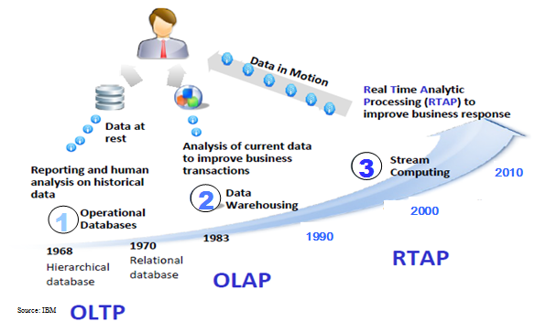
Harnessing Big Data
OLTP: Online Transaction Processing (DBMSs)
OLAP: Online Analytical Processing (Data Warehousing)
RTAP: Real-Time Analytics Processing (Big Data Architecture & technology)

Slide 15
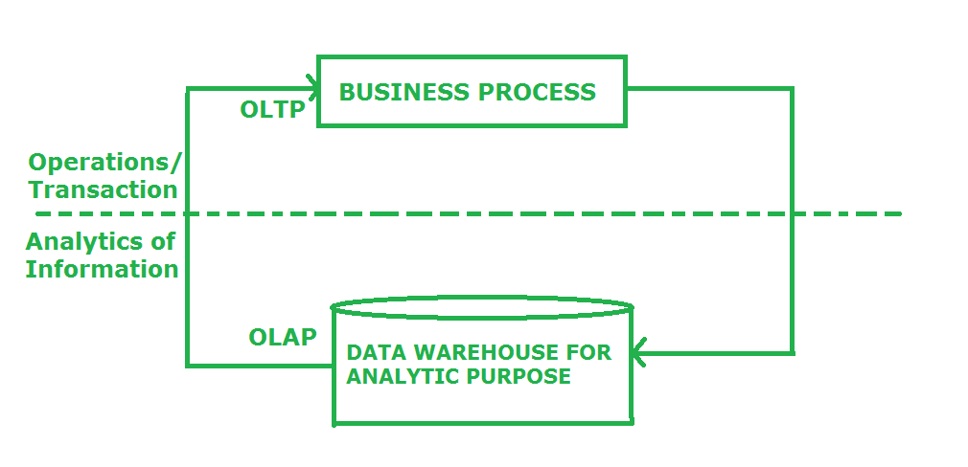
OLTP

Slide 16
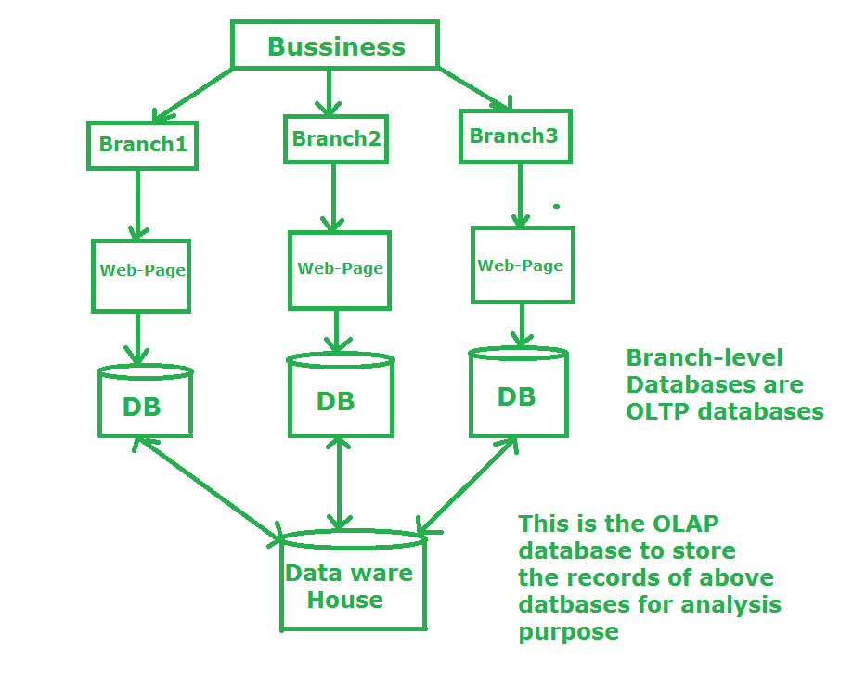
OLAP

Slide 17
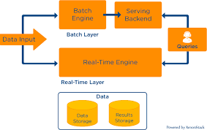
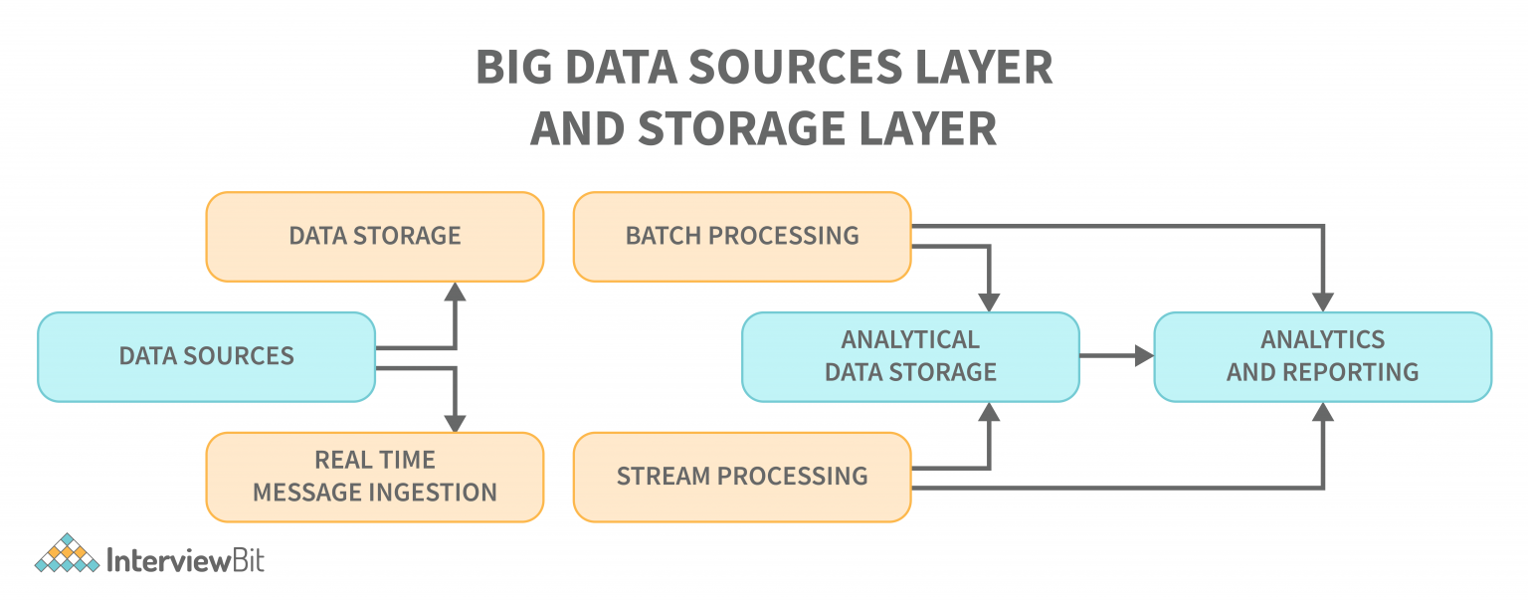
LTAP
Notes:
https://www.youtube.com/watch?v=HPBzBiLG5Sc

Slide 18
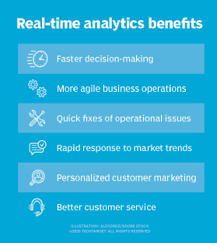
Benefits

Slide 19
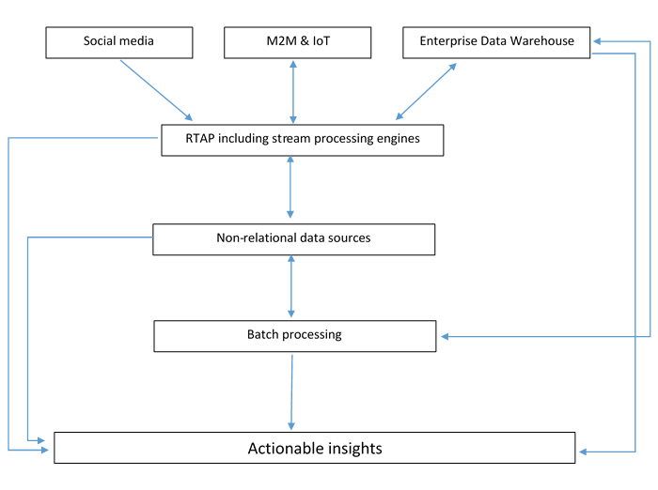
Examples

Slide 20
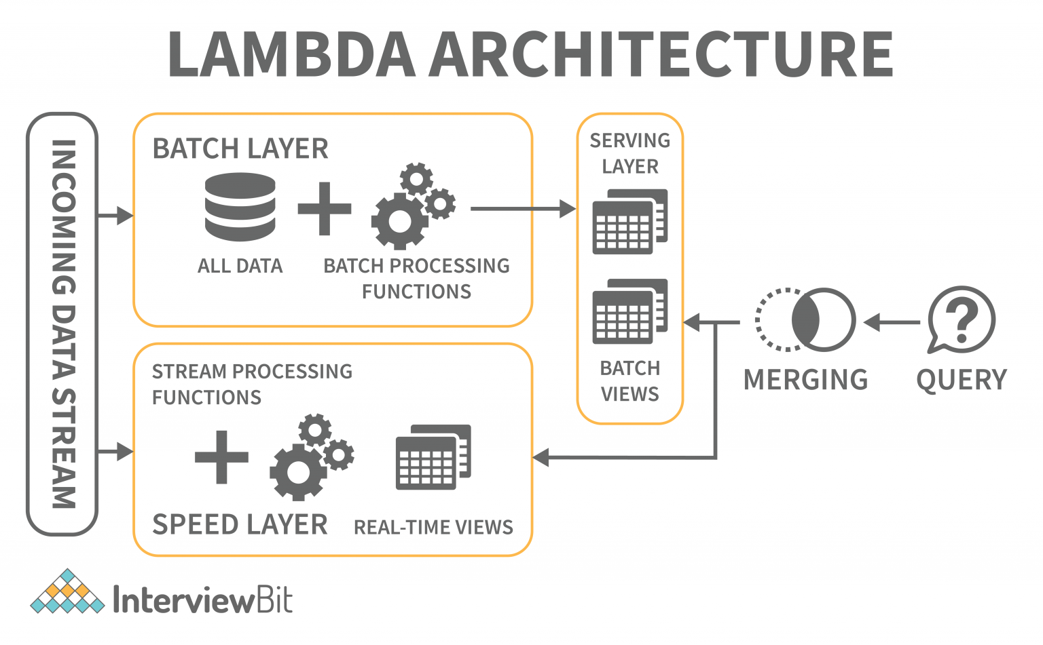
Examples

Slide 21
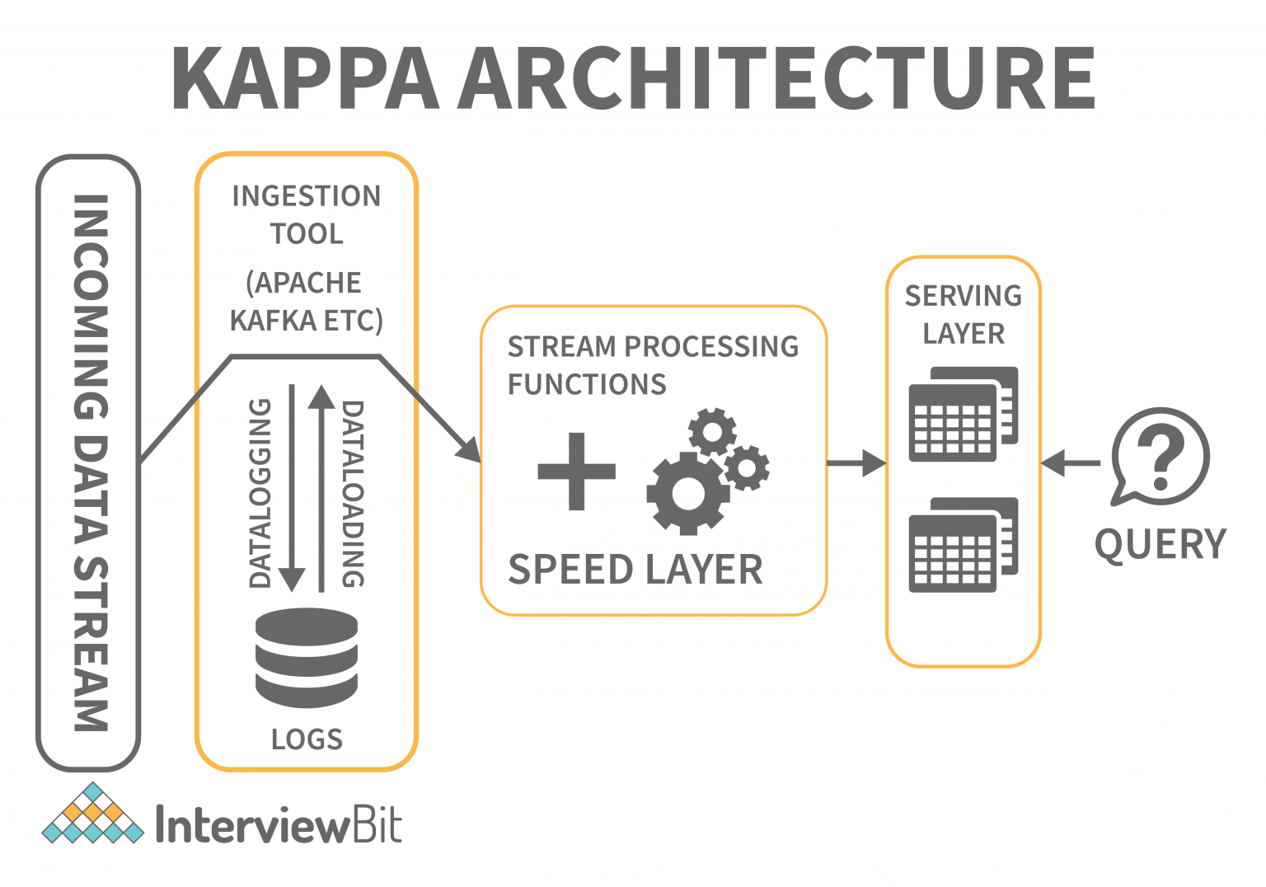
Examples

Slide 22
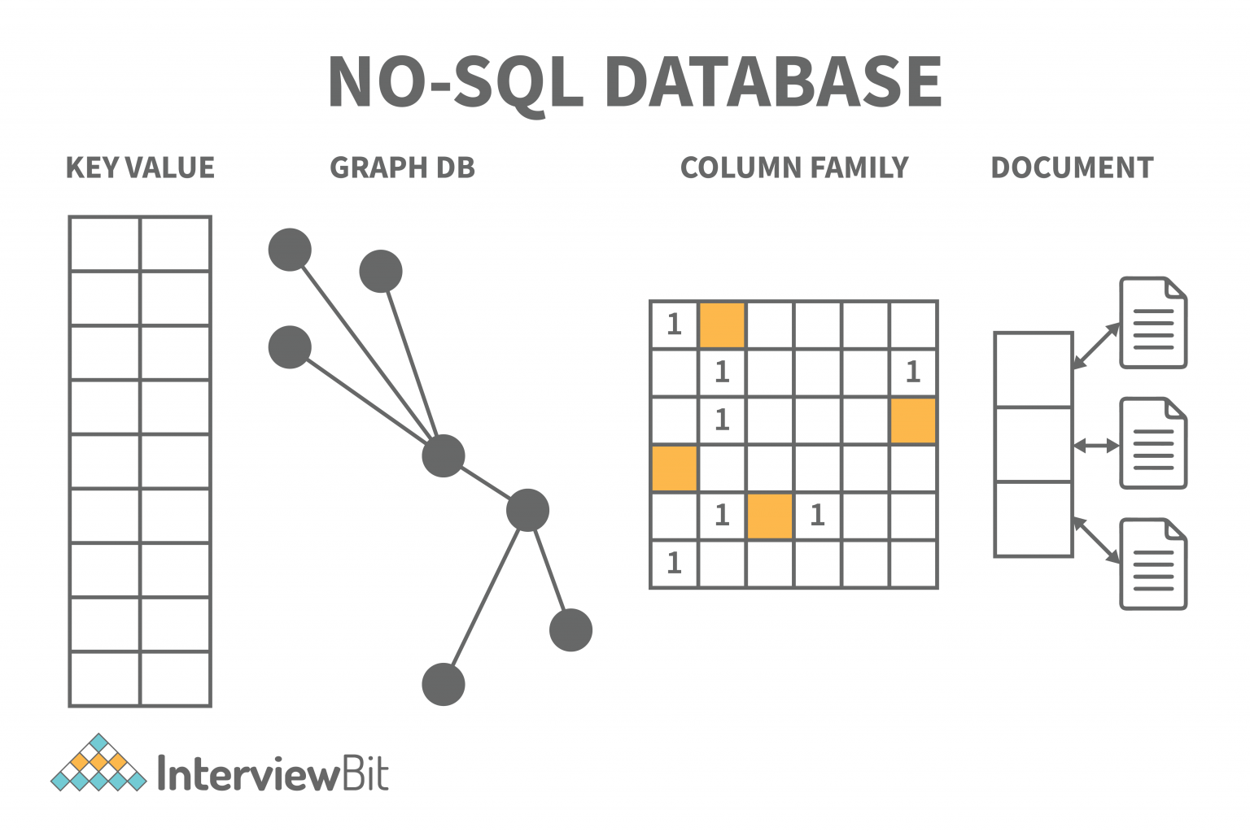
Examples

Slide 23
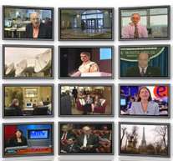

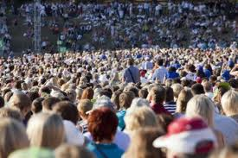

The Model Has Changed…
The Model of Generating/Consuming Data has Changed
Old Model: Few companies are generating data, all others are consuming data
New Model: all of us are generating data, and all of us are consuming data

Slide 24
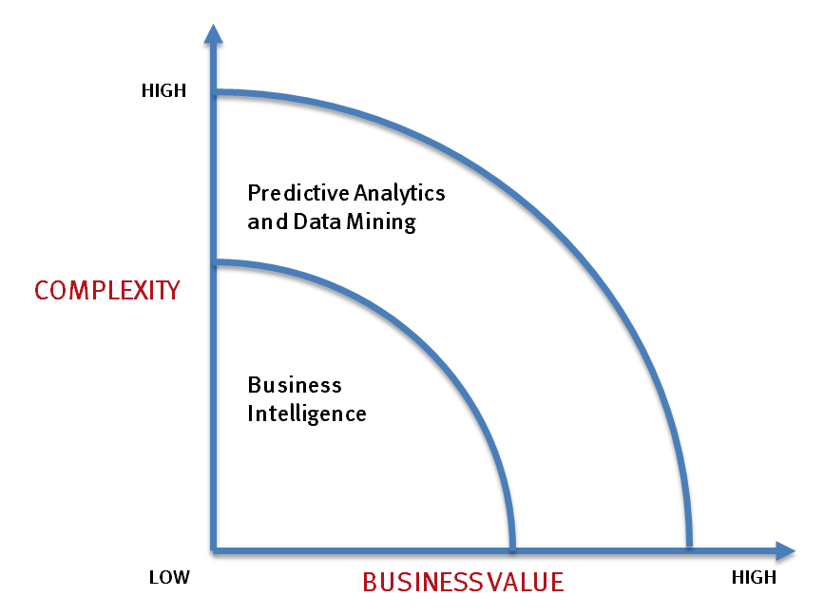
What’s driving Big Data
- Optimizations and predictive analytics
- Complex statistical analysis
- All types of data, and many sources
- Very large datasets
- More of a real-time
- Ad-hoc querying and reporting
- Data mining techniques
- Structured data, typical sources
- Small to mid-size datasets

Slide 25
THE EVOLUTION OF BUSINESS INTELLIGENCE
Interactive Business Intelligence &
In-memory RDBMS
QliqView, Tableau, HANA
Big Data:
Real Time &
Single View
Graph Databases
Speed
Scale
BI Reporting
OLAP &
Dataware house
Business Objects, SAS, Informatica, Cognos other SQL Reporting Tools
Big Data:
Batch Processing &
Distributed Data Store
Hadoop/Spark; HBase/Cassandra
Scale
Speed
1990’s
2000’s
2010’s

Slide 26
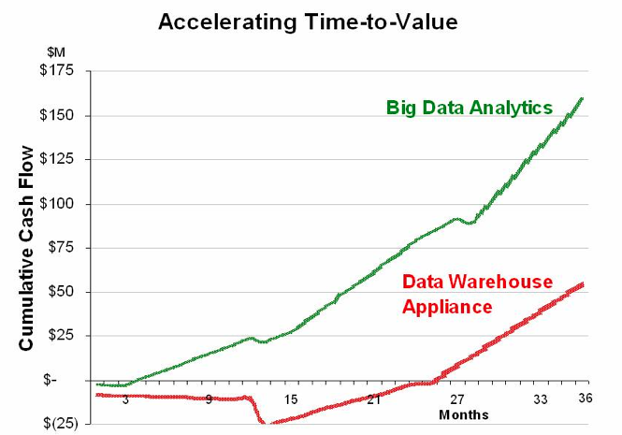
Big Data Analytics
Big data is more real-time in nature than traditional DW applications
Traditional DW architectures (e.g. Exadata, Teradata) are not well-suited for big data apps
Shared nothing, massively parallel processing, scale out architectures are well-suited for big data apps

Slide 27
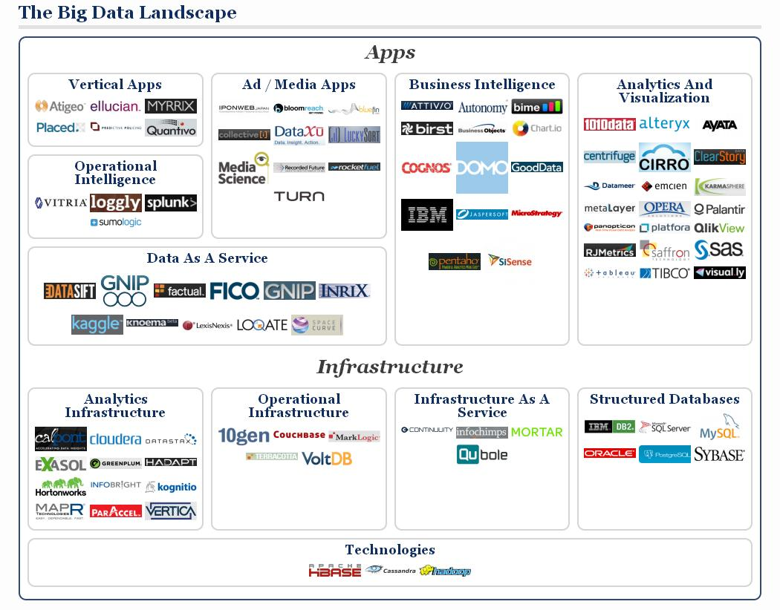

Slide 28
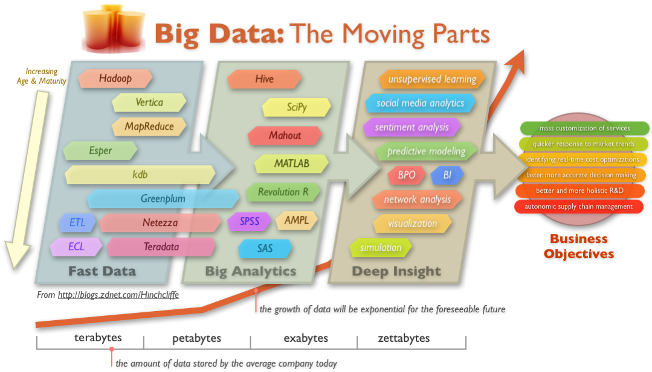
Big Data Technology

Slide 29
Cloud Computing
IT resources provided as a service
  Compute, storage, databases, queues
Clouds leverage economies of scale of commodity hardware
  Cheap storage, high bandwidth networks & multicore processors
  Geographically distributed data centers
Offerings from Microsoft, Amazon, Google, …

Slide 30
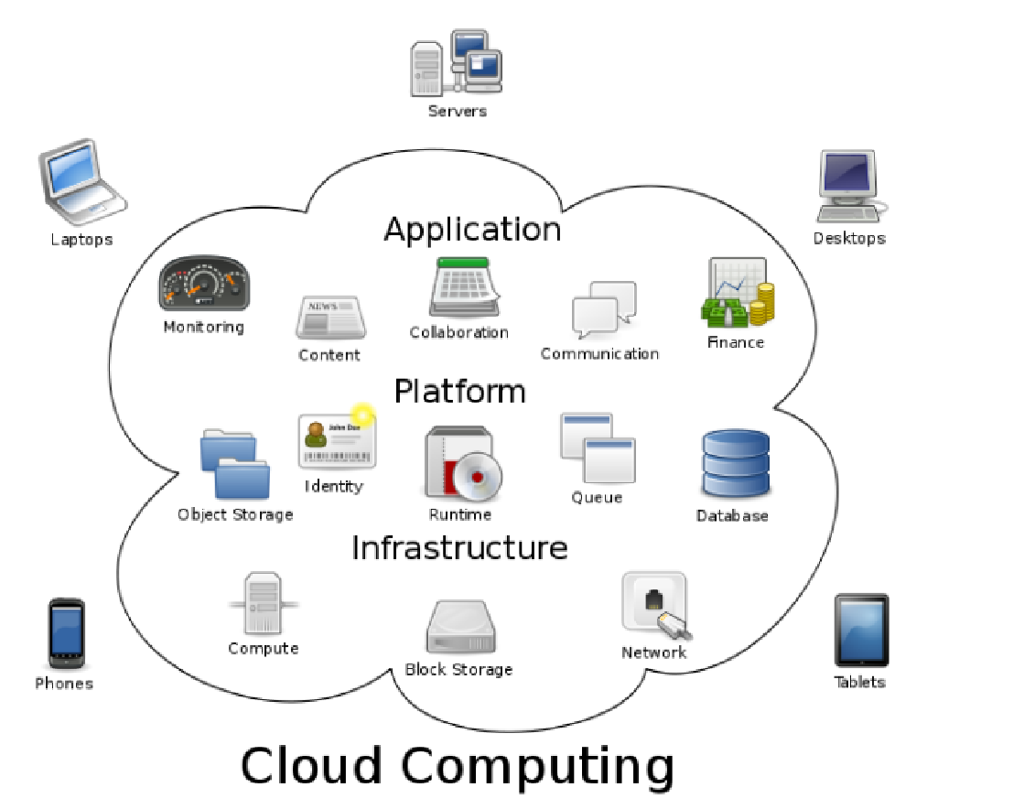
wikipedia:Cloud Computing

Slide 31
Benefits
Cost & management
  Economies of scale, “out-sourced” resource management
Reduced Time to deployment
  Ease of assembly, works “out of the box”
Scaling
  On demand provisioning, co-locate data and compute
Reliability
  Massive, redundant, shared resources
Sustainability
  Hardware not owned

Slide 32
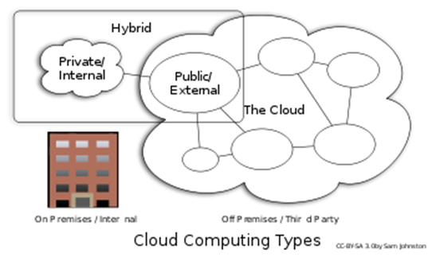
Types of Cloud Computing
Public Cloud: Computing infrastructure is hosted at the vendor’s premises.
Private Cloud: Computing architecture is dedicated to the customer and is not shared with other organisations.
Hybrid Cloud: Organisations host some critical, secure applications in private clouds. The not so critical applications are hosted in the public cloud
  Cloud bursting: the organisation uses its own infrastructure for normal usage, but cloud is used for peak loads.
Community Cloud

Slide 33
Classification of Cloud Computing based on Service Provided
Infrastructure as a service (IaaS)
  Offering hardware related services using the principles of cloud computing. These could include storage services (database or disk storage) or virtual servers.
  Amazon EC2, Amazon S3, Rackspace Cloud Servers and Flexiscale.
Platform as a Service (PaaS)
  Offering a development platform on the cloud.
  Google’s Application Engine, Microsofts Azure, Salesforce.com’s force.com .
Software as a service (SaaS)
  Including a complete software offering on the cloud. Users can access a software application hosted by the cloud vendor on pay-per-use basis. This is a well-established sector.
  Salesforce.coms’ offering in the online Customer Relationship Management (CRM) space, Googles gmail and Microsofts hotmail, Google docs.

Slide 34
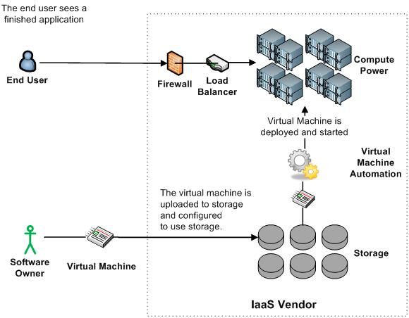
Infrastructure as a Service (IaaS)

Slide 35
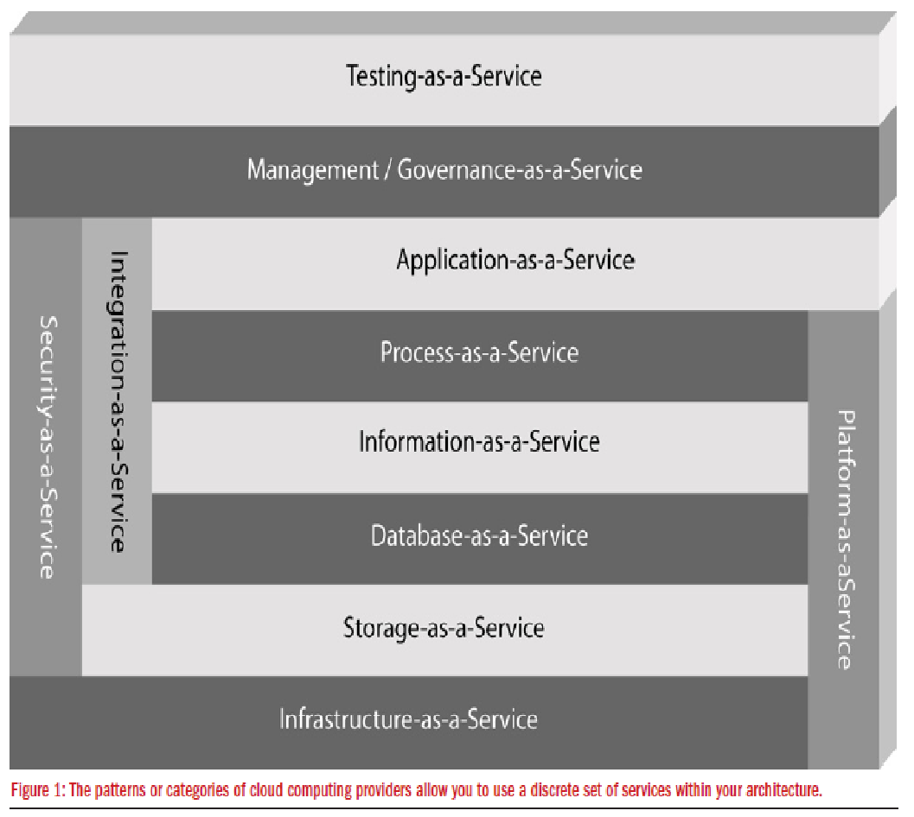
More Refined Categorization
Storage-as-a-service
Database-as-a-service
Information-as-a-service
Process-as-a-service
Application-as-a-service
Platform-as-a-service
Integration-as-a-service
Security-as-a-service
Management/
Governance-as-a-service
Testing-as-a-service
Infrastructure-as-a-service
InfoWorld Cloud Computing Deep Dive

Slide 36
Key Ingredients in Cloud Computing
Service-Oriented Architecture (SOA)
Utility Computing (on demand)
Virtualization (P2P Network)
SAAS (Software As A Service)
PAAS (Platform AS A Service)
IAAS (Infrastructure AS A Servie)
Web Services in Cloud

Slide 37
Enabling Technology: Virtualization
App
App
App
App
App
App
OS
OS
OS
Operating System
Hypervisor
Hardware
Hardware
Traditional Stack
Virtualized Stack

Slide 38
Everything as a Service
Utility computing = Infrastructure as a Service (IaaS)
  Why buy machines when you can rent cycles?
  Examples: Amazon’s EC2, Rackspace
Platform as a Service (PaaS)
  Give me nice API and take care of the maintenance, upgrades, …
  Example: Google App Engine
Software as a Service (SaaS)
  Just run it for me!
  Example: Gmail, Salesforce

Slide 39
Cloud versus cloud
Amazon Elastic Compute Cloud
Google App Engine
Microsoft Azure
GoGrid
AppNexus

Slide 40
The Obligatory Timeline Slide
(Mike Culver @ AWS)
COBOL, Edsel
Amazon.com
ARPANET
Internet
Darkness
Web Awareness
Web as a Platform
Web Services, Resources Eliminated
1959
1969
1982
1996
1997
2001
2004
2006
Dot-Com Bubble
Web 2.0
Web Scale
Computing

Slide 41
AWS
Elastic Compute Cloud – EC2 (IaaS)
Simple Storage Service – S3 (IaaS)
Elastic Block Storage – EBS (IaaS)
SimpleDB (SDB) (PaaS)
Simple Queue Service – SQS (PaaS)
CloudFront (S3 based Content Delivery Network – PaaS)
Consistent AWS Web Services API

Slide 42




What does Azure platform offer to developers?
Your Applications
…
Service
Bus
Workflow
Database
Analytics
Identity
Contacts
Access
Control
…
Reporting
…
Devices
…
Compute
Storage
Manage
…

Slide 43
Google’s AppEngine vs Amazon’s EC2
Python
BigTable
Other API’s
VMs
Flat File Storage
AppEngine:
Higher-level functionality
(e.g., automatic scaling)
More restrictive
(e.g., respond to URL only)
Proprietary lock-in
EC2/S3:
Lower-level functionality
More flexible
Coarser billing model

